Slide 1
Chapter 7: Latches, Flip-Flops, and Timers

Slide 2
Chapter Objectives
After studying this chapter, students should be able to:
Use logic gates to construct basic latches and explain the difference between an S-R latch and a D latch.
Identify the differences between a latch and a flip-flop.
Describe the operation of D, J-K, and T flip-flops.
Understand key characteristics such as propagation delay, setup time, hold time, clock pulse width, and power dissipation in flip-flop circuits.
Apply flip-flops in various applications, including registers and edge-triggered or monostable/one-shot circuits.
Use VHDL to describe latches, flip-flops, and timers, and troubleshoot basic flip-flop circuits.

Slide 3
Chapter Outline
7.1. Latches 7.2. Flip-Flops 7.3. Flip-Flop Operating Characteristics 7.4. Flip-Flop Applications 7.5. One-Shots 7.6. The Astable Multivibrator Multiple-choice test and Problems

Slide 4
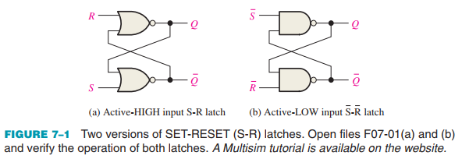
7.1 Latches
The latch is a type of temporary storage device that has two stable states (bistable) and is normally placed in a category separate from that of flip-flops.
The S-R (SET-RESET) Latch

Slide 5
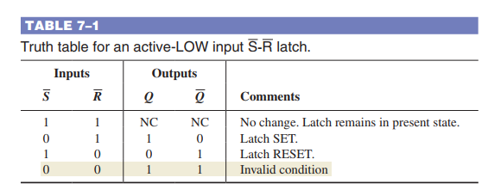
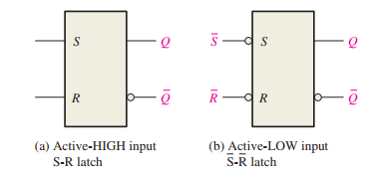
7.1 Latches
The latch is a type of temporary storage device that has two stable states (bistable) and is normally placed in a category separate from that of flip-flops.
The S-R (SET-RESET) Latch

Slide 6
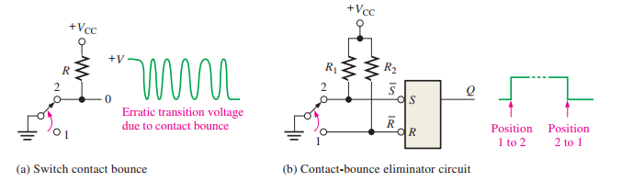
7.1 Latches
The latch is a type of temporary storage device that has two stable states (bistable) and is normally placed in a category separate from that of flip-flops.
An Application The Latch as a Contact-Bounce Eliminator

Slide 7
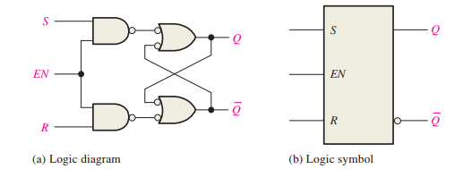

7.1 Latches
The latch is a type of temporary storage device that has two stable states (bistable) and is normally placed in a category separate from that of flip-flops.
The Gated S-R Latch

Slide 8
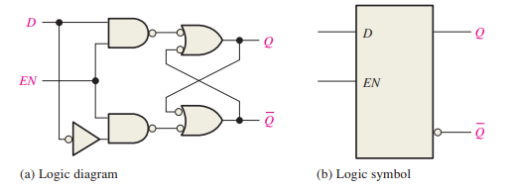
7.1 Latches
The latch is a type of temporary storage device that has two stable states (bistable) and is normally placed in a category separate from that of flip-flops.
The Gated D Latch

Slide 9
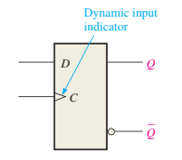
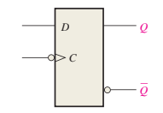
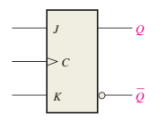
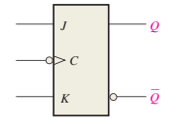
7.2 Flip-Flops
Flip-flops are synchronous bistable devices, also known as bistable multivibrators. In this case, the term synchronous means that the output changes state only at a specified point (leading or trailing edge) on the triggering input called the clock (CLK), which is designated as a control input, C; that is, changes in the output occur in synchronization with the clock An edge-triggered flip-flop changes state either at the positive edge (rising edge) or at the negative edge (falling edge) of the clock pulse and is sensitive to its inputs only at this transition of the clock. Two types of edge-triggered flip-flops are covered in this section: D and J-K.

Slide 10
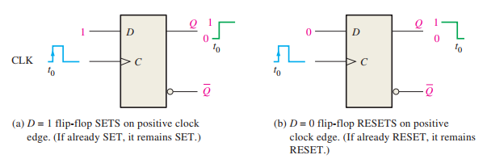
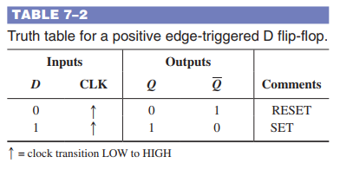
7.2 Flip-Flops
The D Flip-Flop The D input of the D flip-flop is a synchronous input because data on the input are transferred to the flip-flop’s output only on the triggering edge of the clock pulse. When D is HIGH, the Q output goes HIGH on the triggering edge of the clock pulse, and the flip-flop is SET. When D is LOW, the Q output goes LOW on the triggering edge of the clock pulse, and the flip-flop is RESET.

Slide 11
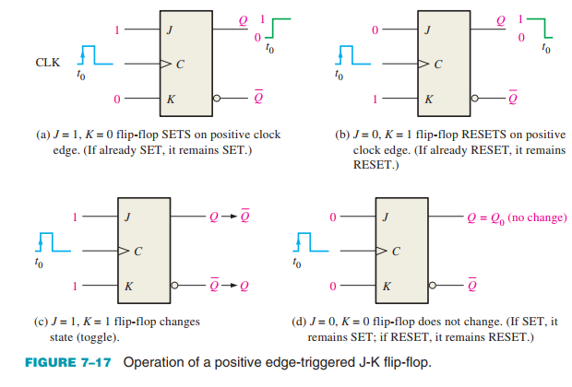
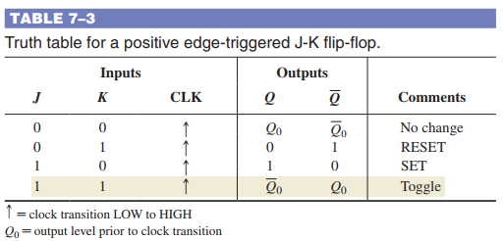
7.2 Flip-Flops
The J-K Flip-Flop The J and K inputs of the J-K flip-flop are synchronous inputs because data on these inputs are transferred to the flip-flop’s output only on the triggering edge of the clock pulse. When J is HIGH and K is LOW, the Q output goes HIGH on the triggering edge of the clock pulse, and the flip-flop is SET.

Slide 12
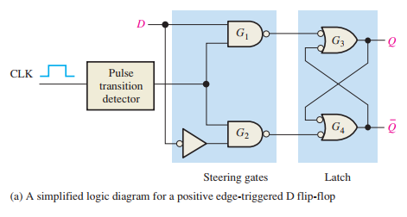
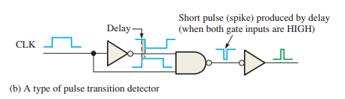

7.2 Flip-Flops
Edge-Triggered Operation D Flip-Flop All logic operations that are performed with hardware can also be implemented in software. For example, the operation of a J-K flip-flop can be performed with specific computer instructions. If two bits were used to represent the J and K inputs, the computer would do nothing for 00, a data bit representing the Q output would be set (1) for 10, the Q data bit would be cleared (0) for 01, and the Q data bit would be complemented for 11. Although it may be unusual to use a computer to simulate a flip-flop, the point is that all hardware operations can be simulated using software.

Slide 13
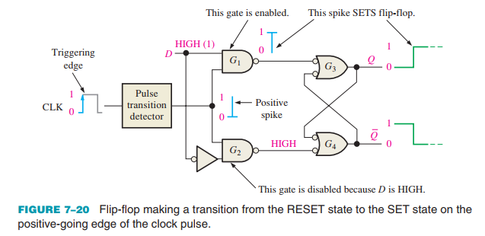
7.2 Flip-Flops
Edge-Triggered Operation D Flip-Flop The Q output of a D flip-flop assumes the state of the D input on the triggering edge of the clock.

Slide 14
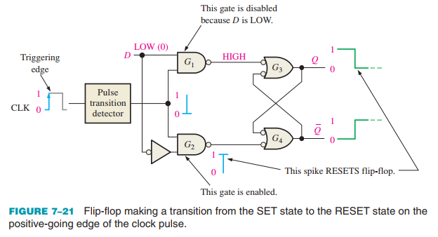
7.2 Flip-Flops
Edge-Triggered Operation D Flip-Flop The Q output of a D flip-flop assumes the state of the D input on the triggering edge of the clock.

Slide 15
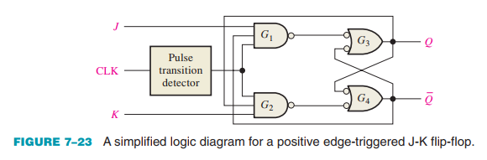
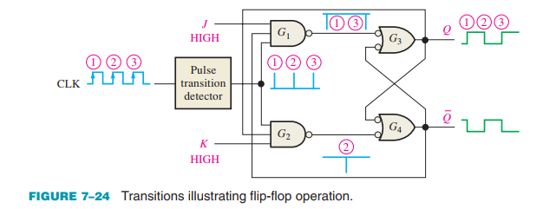
7.2 Flip-Flops
J-K Flip-Flop In the toggle mode, a J-K flip-flop changes state on every clock pulse.

Slide 16
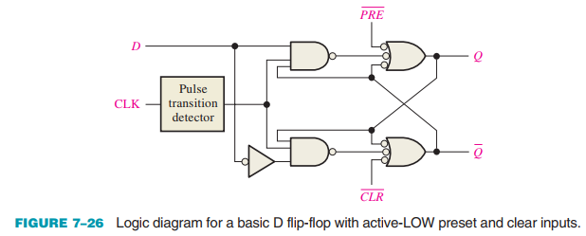
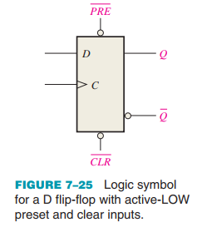
7.2 Flip-Flops
Asynchronous Preset and Clear Inputs An active preset input makes the Q output HIGH (SET) An active clear input makes the Q output LOW (RESET).

Slide 17
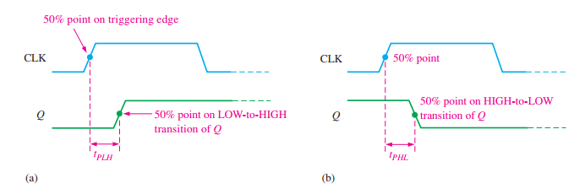
7.3 Flip-Flop Operating Characteristics
The performance, operating requirements, and limitations of flip-flops are specified by several operating characteristics or parameters found on the data sheet for the device. Generally, the specifications are applicable to all CMOS and bipolar (TTL) flip-flops. Propagation Delay Times A propagation delay time is the interval of time required after an input signal has been applied for the resulting output change to occur. Four categories of propagation delay times are important in the operation of a flip-flop:

Slide 18
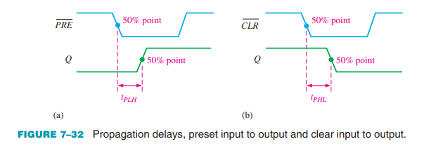
7.3 Flip-Flop Operating Characteristics
The performance, operating requirements, and limitations of flip-flops are specified by several operating characteristics or parameters found on the data sheet for the device. Generally, the specifications are applicable to all CMOS and bipolar (TTL) flip-flops. Propagation Delay Times A propagation delay time is the interval of time required after an input signal has been applied for the resulting output change to occur. Four categories of propagation delay times are important in the operation of a flip-flop:

Slide 19
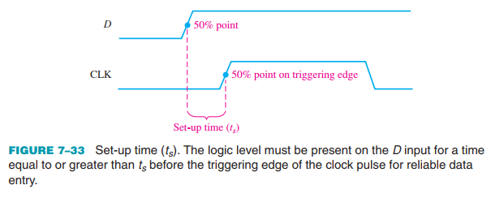
7.3 Flip-Flop Operating Characteristics
Set-up Time The set-up time (ts) is the minimum interval required for the logic levels to be maintained constantly on the inputs (J and K, or D) prior to the triggering edge of the clock pulse in order for the levels to be reliably clocked into the flip-flop.

Slide 20
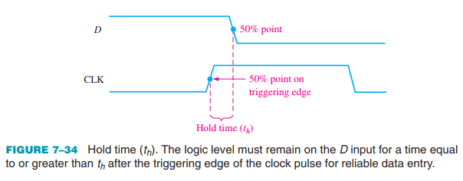
7.3 Flip-Flop Operating Characteristics
Hold Time The hold time (th) is the minimum interval required for the logic levels to remain on the inputs after the triggering edge of the clock pulse in order for the levels to be reliably clocked into the flip-flop.

Slide 21
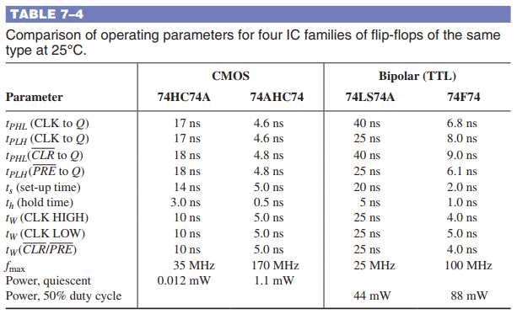
7.3 Flip-Flop Operating Characteristics
Comparison of Specific Flip-Flops Table 7–4 provides a comparison, in terms of the operating parameters discussed in this section, of four CMOS and bipolar (TTL) flip-flops of the same type but with different IC families (HC, AHC, LS, and F)

Slide 22
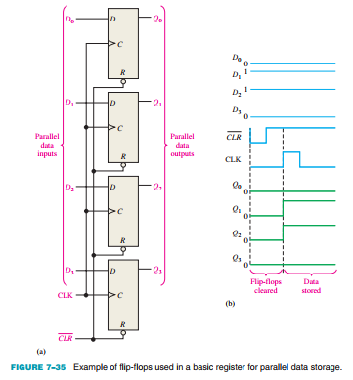
7.4 Flip-Flop Applications
Parallel Data Storage A common requirement in digital systems is to store several bits of data from parallel lines simultaneously in a group of flip-flops.

Slide 23
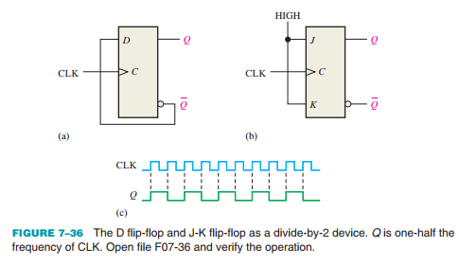
7.4 Flip-Flop Applications
Frequency Division Another application of a flip-flop is dividing (reducing) the frequency of a periodic waveform. When a pulse waveform is applied to the clock input of a D or J-K flip-flop that is connected to toggle (D = Q or J = K = 1), the Q output is a square wave with one-half the frequency of the clock input.

Slide 24
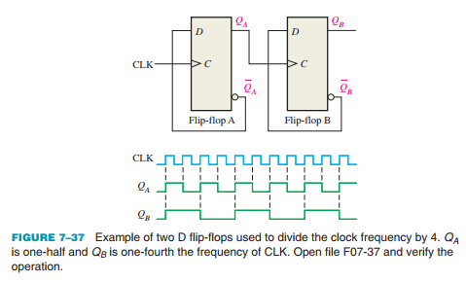
7.4 Flip-Flop Applications
Frequency Division Further division of a clock frequency can be achieved by using the output of one flipflop as the clock input to a second flip-flop.

Slide 25
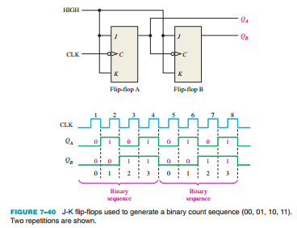
7.4 Flip-Flop Applications
Counting Both flip-flops are initially RESET. Flip-flop A toggles on the negative-going transition of each clock pulse. The Q output of flip-flop A clocks flip-flop B, so each time QA makes a HIGH-to-LOW transition, flip-flop B toggles. The resulting QA and QB waveforms are shown in the figure.

Slide 26
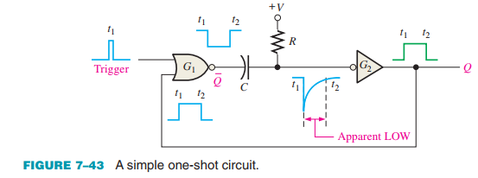
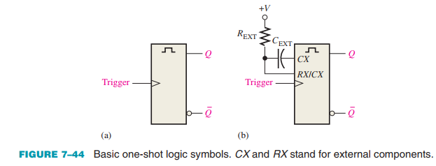
7.5 One-Shots
The one-shot, also known as a monostable multivibrator, is a device with only one stable state. A one-shot is normally in its stable state and will change to its unstable state only when triggered.
A one-shot produces a single pulse each time it is triggered

Slide 27
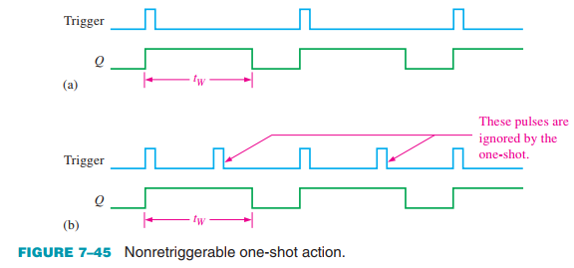
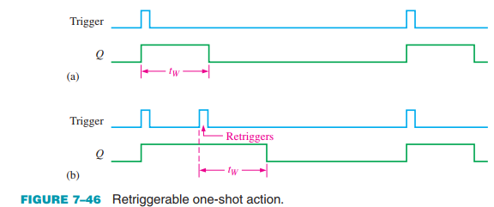
7.5 One-Shots
A nonretriggerable one-shot will not respond to any additional trigger pulses from the time it is triggered into its unstable state until it returns to its stable state. In other words, it will ignore any trigger pulses occurring before it times out. The time that the one-shot remains in its unstable state is the pulse width of the output.

Slide 28
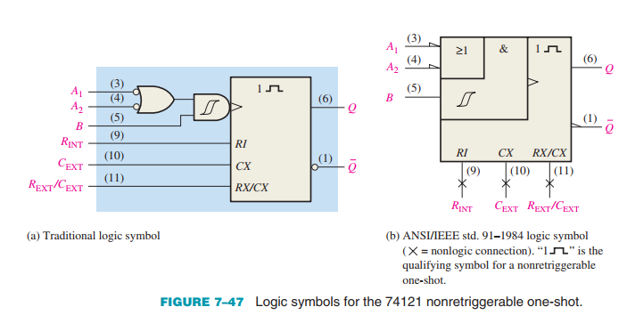
7.5 One-Shots
Nonretriggerable One-Shot The 74121 is an example of a nonretriggerable IC one-shot.

Slide 29
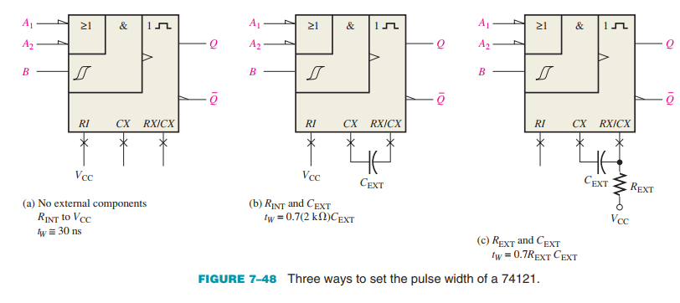
7.5 One-Shots
Setting the Pulse Width A typical pulse width of about 30 ns is produced when no external timing components are used and the internal timing resistor (RINT) is connected to VCC.

Slide 30
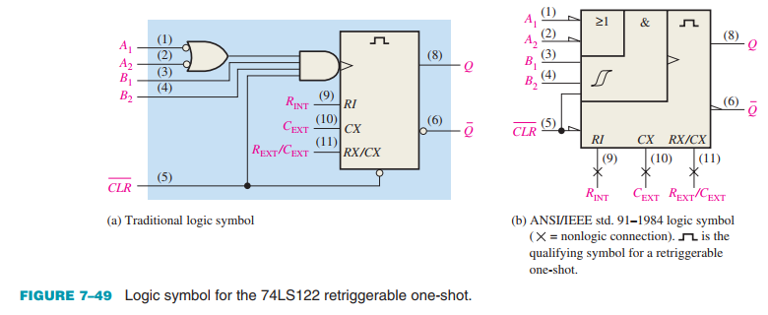

7.5 One-Shots
Retriggerable One-Shot The 74LS122 is an example of a retriggerable IC one-shot with a clear input.

Slide 31
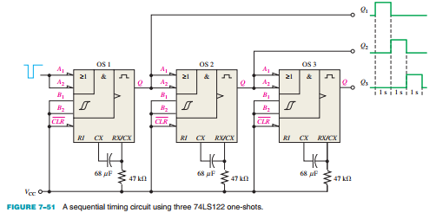
7.5 One-Shots
An Application One practical one-shot application is a sequential timer that can be used to illuminate a series of lights. This type of circuit can be used, for example, in a lane change directional indicator for highway construction projects or in sequential turn signals on automobiles.

Slide 32
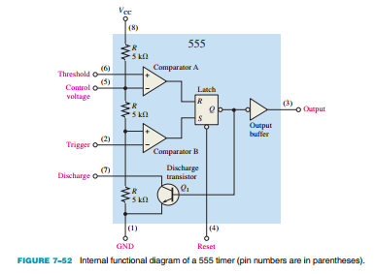
7.5 One-Shots
The 555 Timer as a One-Shot The 555 timer is a versatile and widely used IC device because it can be configured in two different modes as either a monostable multivibrator (one-shot) or as an astable multivibrator (pulse oscillator)

Slide 33
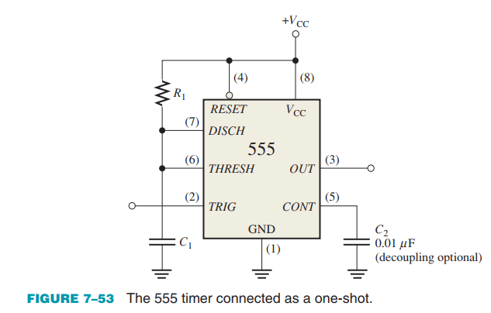

7.5 One-Shots
Monostable (One-Shot) Operation An external resistor and capacitor connected as shown in Figure 7–53 are used to set up the 555 timer as a non-retriggerable one-shot:

Slide 34
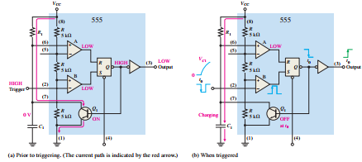
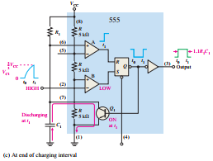
7.5 One-Shots
Monostable (One-Shot) Operation An external resistor and capacitor connected as shown in Figure 7–53 are used to set up the 555 timer as a non-retriggerable one-shot:

Slide 35
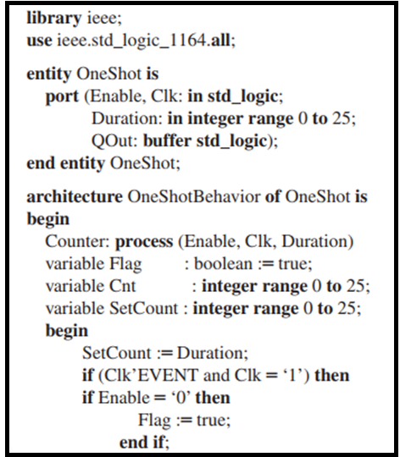
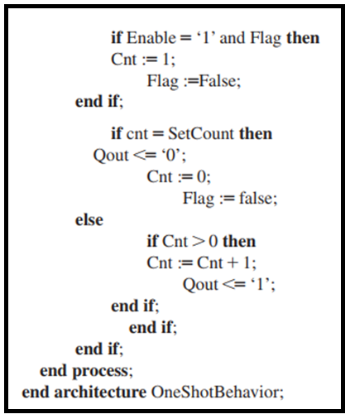
7.5 One-Shots
One-Shot with VHDL An example of a VHDL program code for a one-shot is as follows:

Slide 36
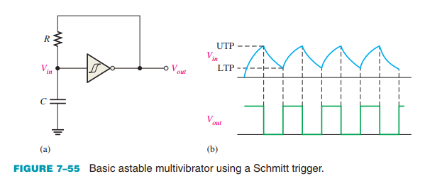
7.6 The Astable Multivibrator
An astable multivibrator is a device that has no stable states; it changes back and forth (oscillates) between two unstable states without any external triggering. The resulting output is typically a square wave that is used as a clock signal in many types of sequential logic circuits. Astable multivibrators are also known as pulse oscillators.

Slide 37
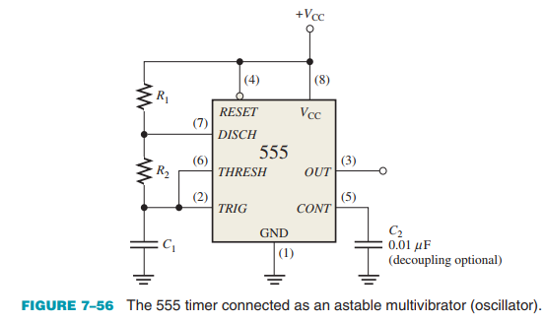
7.6 The Astable Multivibrator
The 555 Timer as an Astable Multivibrator

Slide 38

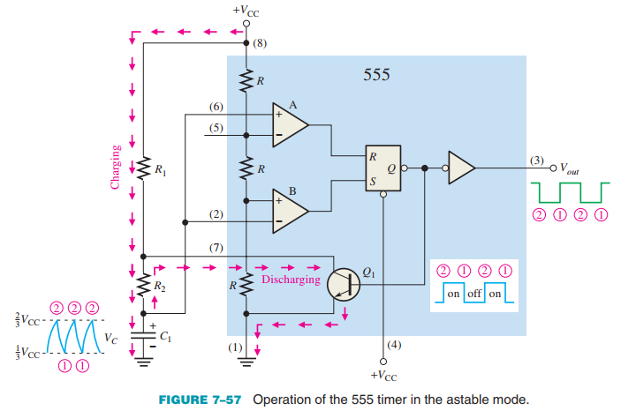

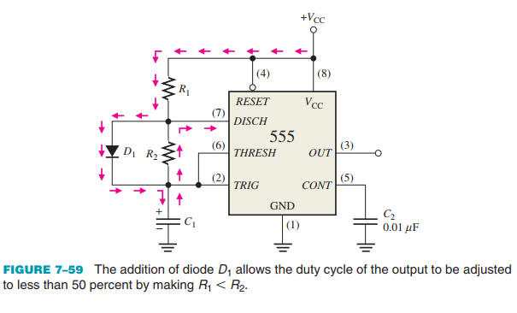
7.6 The Astable Multivibrator
The 555 Timer as an Astable Multivibrator

Slide 39
SUMMARY
Chapter 7: Latches, Flip-Flops, and Timers
Latches are bistable devices whose state normally depends on asynchronous inputs.
Edge-triggered flip-flops are bistable devices with synchronous inputs whose state depends on the inputs only at the triggering transition of a clock pulse. Changes in the outputs occur at the triggering transition of the clock.
Monostable multivibrators (one-shots) have one stable state. When the one-shot is triggered, the output goes to its unstable state for a time determined by an RC circuit.
Astable multivibrators have no stable states and are used as oscillators to generate timing waveforms in digital systems.

Slide 40
MULTIPLE-CHOICE TEST AND PROBLEMS
Complete the true/false questions, multiple-choice questions, and end-of-chapter exercises in the primary textbook.

